Slide 1
1. Transformers and its operation 2. Types of transformer 3. Cables – and its construction 4. Types and Cable Sizing 5. Concept of Capacitors 6. Types of Capacitors 7. Power Factor Improvement
Unit:2

Slide 2
Transformer
Transformer is an static electromagnetic device that transforms electrical energy from one circuit to another circuit with change in voltage level, keeping frequency and power constant.
Key points:
Transform electrical power in AC form by change in voltage level from primary circuit to secondary circuit.
frequency is constant.
Based on electromagnetic induction, where two electric circuits are in mutual inductive influence of each other.

Slide 3
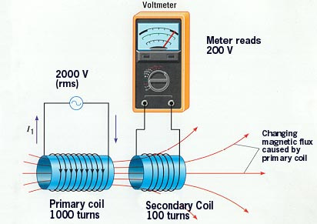
Continued...

Slide 4
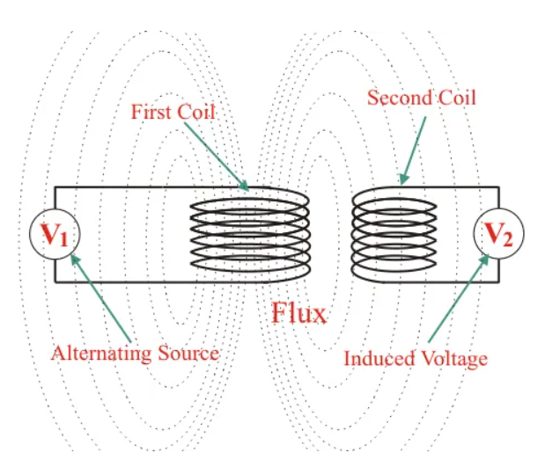
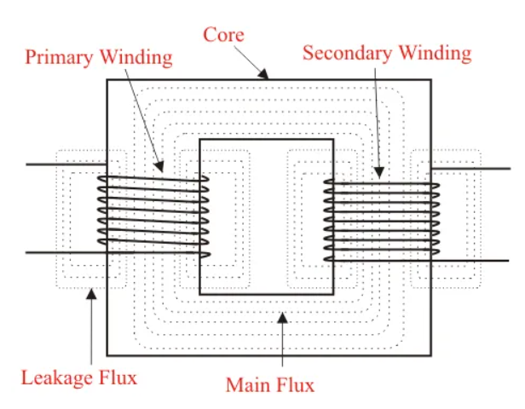
Working of a Transformer
Alternating voltage v₁ is applied to the primary winding, a current is established in the primary winding which produces a alternating flux in the core.
Flux links with both primary and secondary windings.
As per Faraday’s law of electromagnetic Induction, Flux will cause a Self induced EMF in primary and Mutually induced EMF in secondary.
As per Lenz’s law, primary induced EMF will oppose the applied voltage as a result this primary induced EMF will be almost equals to the primary applied voltage.
When a load is connected to the secondary side, current will start flowing in the secondary winding.
The voltage induced in the secondary winding is responsible to deliver power to the load connected to it.
Thus power is transferred from one circuit to another.

Slide 5
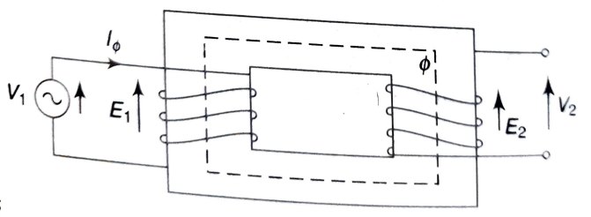
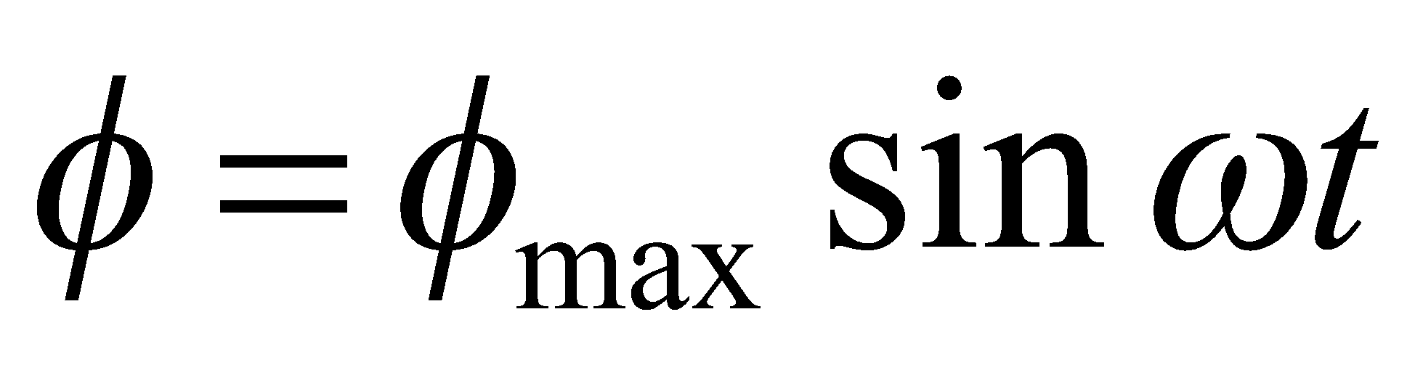
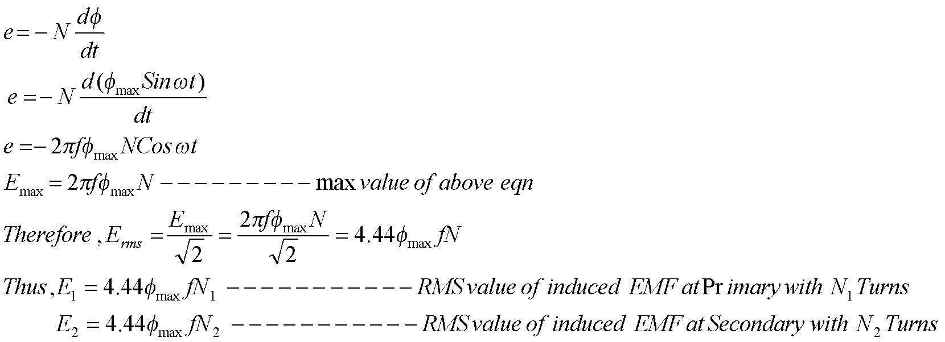
EMF EQUATION OF TRANSFORMER
The applied voltage is sinusoidal at the primary, the flux (Φ) produced by the primary current is also sinusoidal.

Slide 6
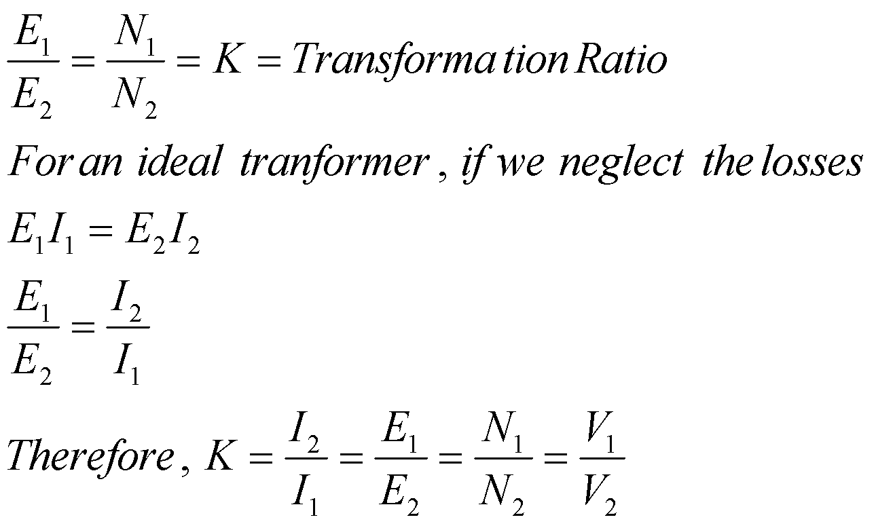
Continued...
Way To Rembember above Relationship - Current is transformed in reverse ratio of the voltage and turn’s ratio.
With the selection of K: Two Cases are possible-
If N1 > N2 or, E1 > E2 ................................ Step down Transformer
If N2 > N1 or, E2 > E1 ................................ Step up Transformer

Slide 7
Construction of a Single Phase Transformer
Consist of Primary and Secondary Windings placed in a magnetic Core
Magnetic Core is a stack of thin silicon steel laminations (CRGO)
Lamination reduces Eddy current loss and Steel reduces hysteresis loss
The core provides a low reluctance path for electromagnetic flux and supports the primary and secondary windings.

Slide 8
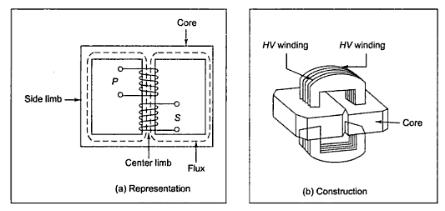
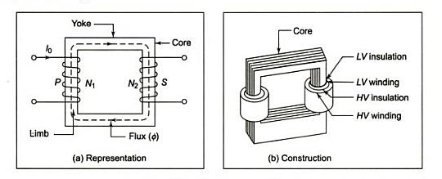
Continued...
Based on construction, two types of transformers- Shell type and Core type
Vertical legs is called Limbs.
Horizontal portion is called Yoke.
In Shell type, flux in central limb is divided into two equal parts and returns through outer two parts. Whereas, in core type, flux has single path around the legs.
LV winding is placed usually adjacent to steel core and HV winding is placed outside to minimize the amount of insulation.
For reduction of leakage flux half of each winding is placed on each leg of the core.
Shell Type Transformer
Core Type Transformer

Slide 9
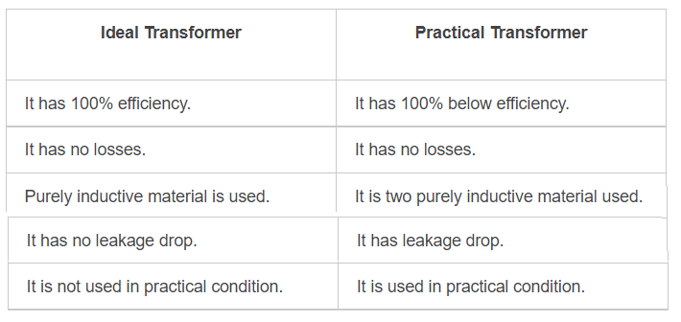
Ideal and Practical Transformers

Slide 10
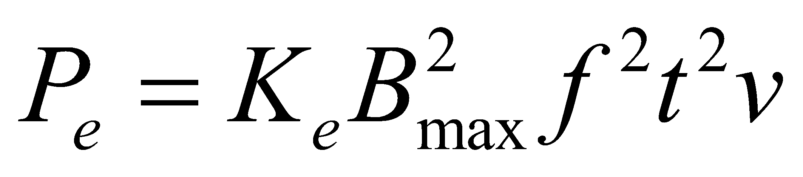
Losses in Transformer
Two Types -
1. Copper loss or I²R loss or Ohmic loss:
2. Iron loss or Core loss:
Eddy current loss
Hysteresis loss
Eddy current Loss (P_{e})- The eddy currents are the circulating currents set up in the core. These are produced due to the magnetic flux being cut by the core. The loss occurred due to this is called eddy current loss (Watt).
Where, K_{e} is the constant depends on the conductor. B_{max} is the maximum flux density in (Wb/m²), f is frequency, t is thickness of the lamination (metre)
v is the volume of the core (m³)

Slide 11
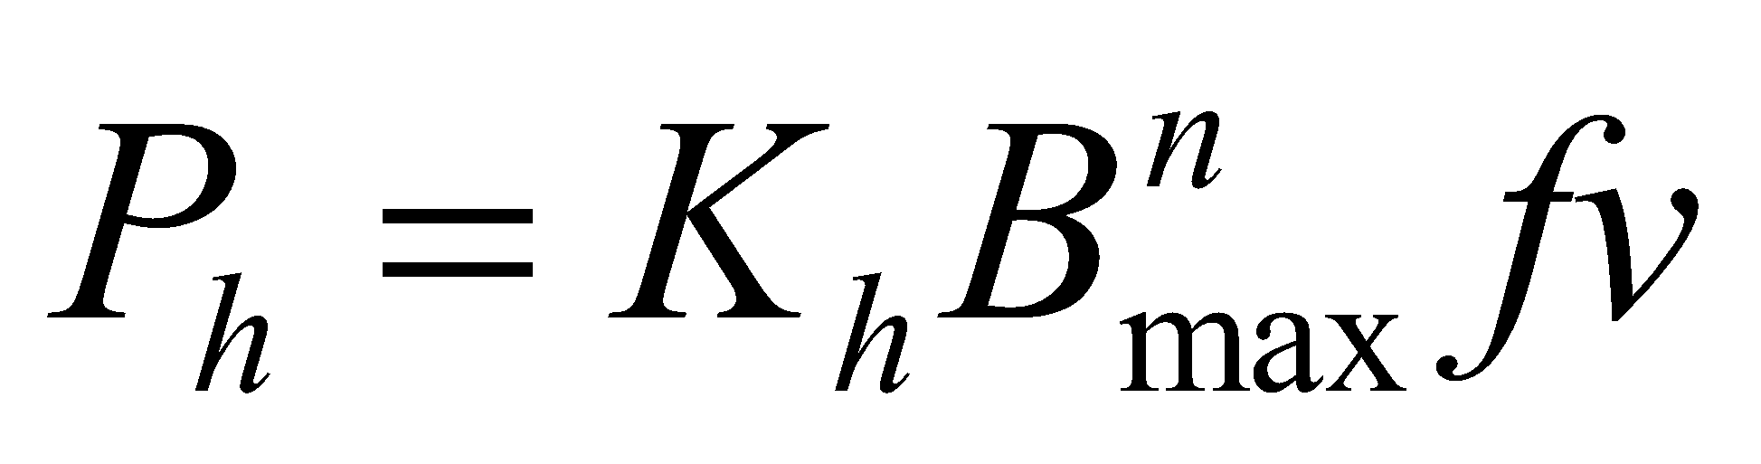
Hysteresis loss (P_{h})- When alternating current flows through the winding , the core of the material undergoes cyclic processes of magnetisation and demagnetisation. The occurred loss due to this process is called hysteresis loss (Watt).
K_{h} is the hysteresis coefficient and n is also another constant which depends on material (1.5<n<2.5)

Slide 12
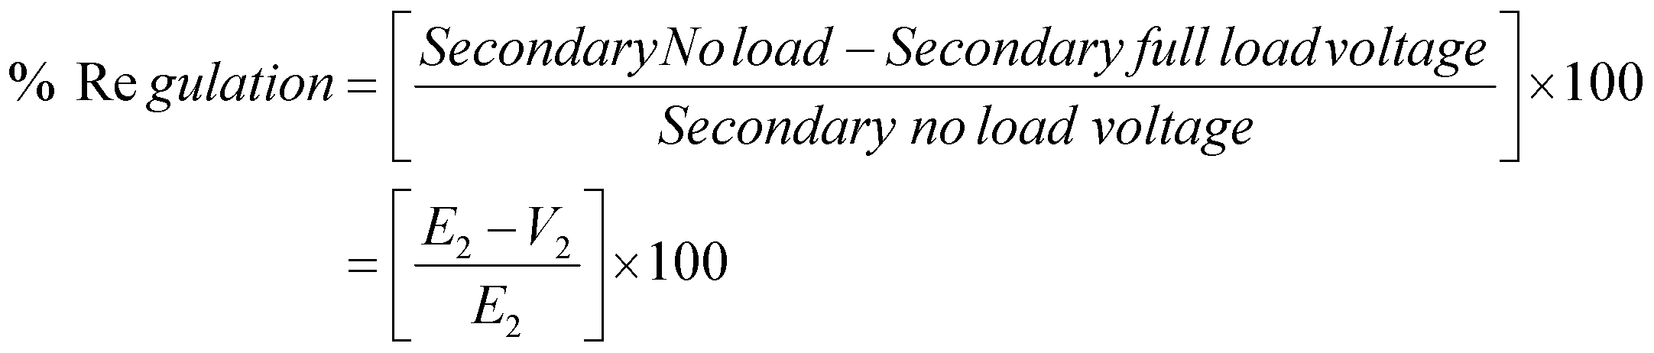
Regulation of Transformer
The percentage decrease in the terminal voltage of a transformer from no-load to full load condition at constant applied voltage.
E₂ is secondary no load voltage
V₂ is terminal voltage at secondary

Slide 13
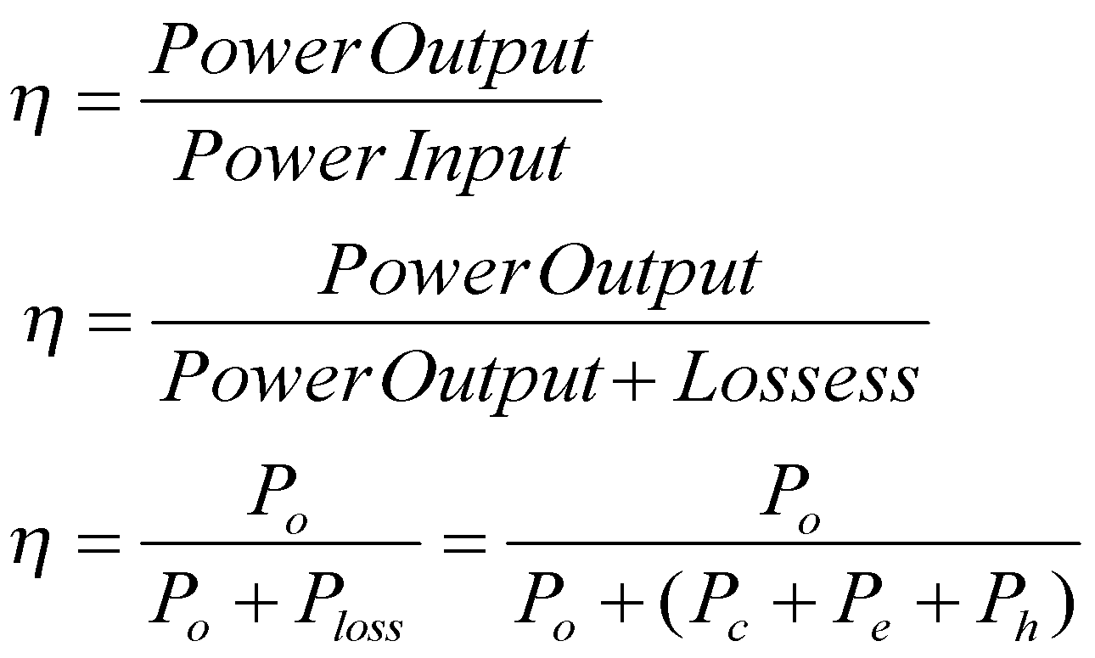
Efficiency of Transformer
Where, η is the efficiency
P_{o} is Power output
Ploss is total loss
P_{c} is copper loss
P_{e} is Eddy current loss
P_{h} Hysteresis loss
Condition for maximum efficiency-
Copper Loss (P_{c}) = Iron Loss (P_{i})
=> P_{c} = P_{e} + P_{h}
Output at maximum efficiency = full load output

Slide 14
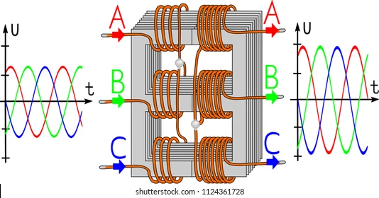
3-phase Transformer

Slide 15
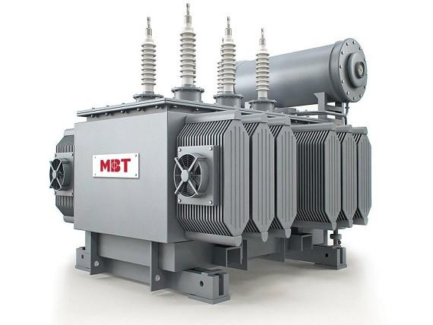
Parts of a Three-phase Transformer
Core
LV winding
HV winding
Tapped winding
Tap leads
LV bushings
HV bushings
Radiator
On-load tap changer
Conservator
Tank
Clamping frame

Slide 16
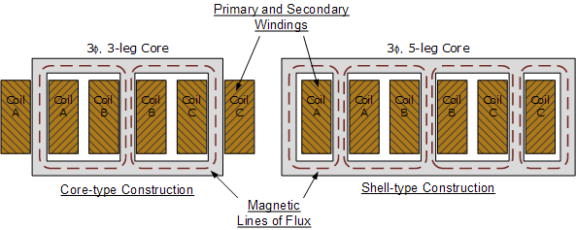
Two types of transformer
Core type
Shell type

Slide 17
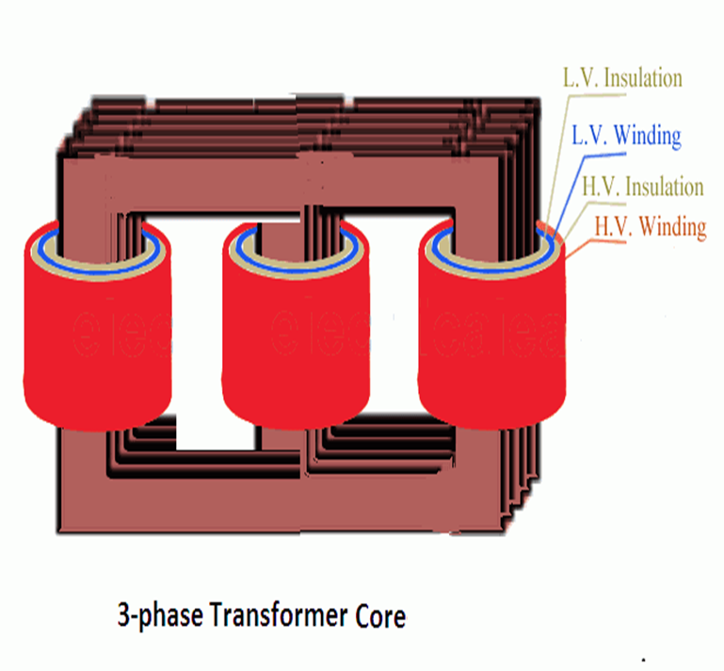
Core-type Transformer
The windings are evenly split and wound on the limbs of the core.
The core consists of three limbs on the same plane.
Each of these limbs contains both the primary and secondary windings.
These windings are referred to as the high voltage and low voltage windings.

Slide 18
The low voltage windings are wound closest to the core since it is easier to insulate.
The high voltage coil is then wrapped around the low voltage winding with insulation between them.
In this construction, the windings are magnetically coupled with each other where one winding uses the other two limbs as a return path for its magnetic flux.

Slide 19
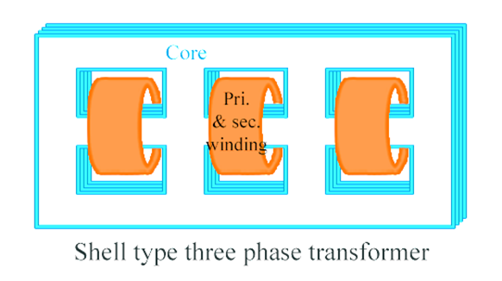
Shell type transformer
This type of transformer has a core with five limbs.
It can be viewed as three separate single-phase transformers since the magnetic fields of the three phases are almost independent of each other.
The high voltage and low voltage windings are wrapped around the three main limbs similar to the core-type where the low voltage is closest to the core.

Slide 20
By having the two outer limbs, the magnetic flux has additional return paths.
As the magnetic field comes to the yoke, the magnetic flux divides into two.
Yoke and the outer limbs can be sized half of the main limbs.
By decreasing the size of the yoke, the overall height of the transformer can also be decreased.

Slide 21
Windings
Transformer carries two sets of winding per phase –
Primary winding and secondary winding.
These winding consists of several turns of copper or aluminium conductors, insulated from each other and the transformer core.
The type and arrangement of winding used for transformers depend upon the current rating, short circuit strength, temperature rise, impedance and surge voltages.
Out of the primary winding and secondary winding, the one which is rated for higher voltage is known as High voltage (HV) winding and the other is known as the Low voltage (LV) winding.

Slide 22
Insulation
Insulation is the most important part of transformers. Insulation failures can cause the most severe damage to transformers.
Insulation is required between the windings and the core, between windings, between each turn of the winding and between all current-carrying parts and the tank.
The insulators should have high dielectric strength, good mechanical properties and high-temperature withstand ability.
Synthetic materials, paper, cotton etc are used as insulation in transformers.

Slide 23
Tank
The main tank is a part of a transformer serves two purposes:
Protects the core and the windings from the external environment.
Serves as a container for oil and support for all other transformer accessories.
Tank bodies are made by fabricating rolled steel plates to containers. They are provided with lifting hooks and cooling tubes.
In order to reduce weight and stray losses, aluminium sheets are also used instead of steel plates. However, aluminium tanks are costlier than steel ones.

Slide 24
Terminal and bushings
Terminals:
For connecting incoming and outgoing cables, terminals are present in transformers.
They are mounted upon the bushings and is connected to the ends of the windings.
Bushings:
These are insulators that forms a barrier between the terminals and the tank. They are mounted over the transformer tanks.
They serve as a safe passage for the conductors connecting terminals to the windings.
They are made from porcelain or epoxy resins.

Slide 25
Transformer oil
Transformer oil provides added insulation between the conducting parts, better heat dissipation, and fault detection features.
Hydro-carbon mineral oil is used as transformer oil. It is composed of aromatics, paraffin, naphthenes, and olefins.
Transformer oil has a flashpoint of 310 degrees Celsius,

Slide 26
Oil Conservators
The oil conservator is moved on the top of the transformers and is located well above the tank and bushings.
Normally a rubber bladder is present in some oil conservators.
The transformer oil expands and contracts with an increase and decrease in temperature.
The oil conservator provides adequate space for oil expansion.
It is connected to the main tank through a pipe. A level indicator is fitted to the conservator to indicate the oil level inside.

Slide 27
Breather
Breather is present in all oil-immersed transformers that have a conservator tank.
It is necessary to keep the oil-free from moisture. As the temperature variations cause the transformer oil to expand and contract, air flows in and out of the conservator tank.
This air should be free from moisture. Breather serves this purpose.
A breather is attached to the end of the air pipe such that the air enters and exits the conservator through it.
The silica gel present in the breathers removes moisture from the air and delivers moisture-free air to the conservator.

Slide 28
Radiators and fans
The power lost in the transformer is dissipated in the form of heat.
Dry transformers are mostly natural air-cooled.
In oil-immersed transformers, a variety of cooling methods are followed.
Depending on the kVA rating, power losses, and level of cooling requirements, radiators and cooling fans are mounted on the transformer tank.
The heat generated in the core and winding is passed to the surrounding transformer oil. This heat is dissipated at the radiator.
In larger transformer forced cooling is achieved with the help of cooling fans fitted to the radiators.

Slide 29
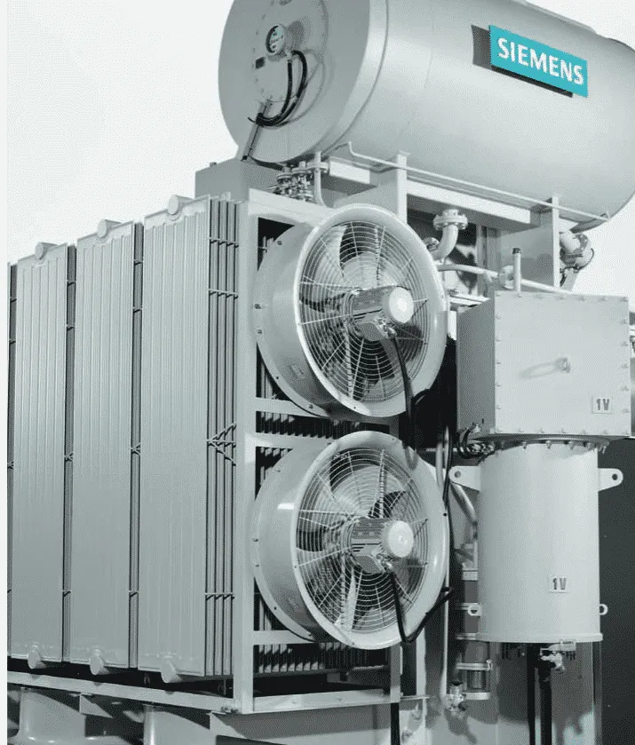

Slide 30
Explosion vent
An explosion vent acts as an emergency exit for oil and air gases inside a transformer. It is a metallic pipe with a diaphragm at one end, held slightly above the conservator tank.
Faults occurring under oil elevates the pressure inside the tank to dangerous levels.
Under such circumstances, the diaphragm ruptures at a relatively low pressure to release the forces from within the transformer to the atmosphere.

Slide 31
Tap changers
Tap changers are used to adjust the secondary voltage of transformers.
They are designed to change the turns ratio of the transformer as required.
There are two types of tap changers: On-load tap changers and Off-load tap changers.
Off-load tap changers are designed to operate only when the transformer is not supplying any loads whereas on-load tap changers are capable of operating without interrupting the current flow to the load. Automatic tap changers are also available.

Slide 32
Buchholz relay
It is an oil and gas actuated relay that is used to sense faults occurring in the parts immersed in the oil.
It is used in oil-immersed transformers rated over 500kVA.
Short circuits occurring under the transformer oil generate enough heat to decompose the oil into hydrogen, carbon monoxide, methane etc.
These gases gradually move towards the conservator tank through the connecting pipe. Buchholz relay, which is mounted on the pipe connecting the conservator tank and the main tank, senses these gases and activates the trip and alarm circuits.
The trip circuit opens the circuit breaker supplying current to the primary winding and interrupts the current flow.

Slide 33
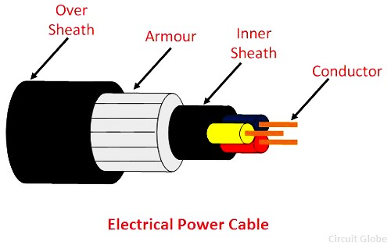
Cable
A power cable is an assembly of two or more electrical conductors, usually held together with an overall sheath.
It is used for the transmission of high voltages in a place where overhead lines are impracticable to use like, the sea, airfield crossing, etc.
Power cables may be installed as permanent wiring within buildings, buried in the ground, run overhead, or exposed.

Slide 34
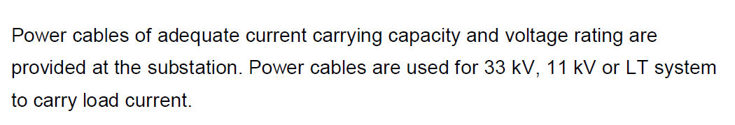
Applications of Cable
Electrification of commercial and residential buildings.
Power generating stations.
Power transmission and distribution system.

Slide 35
Construction of Cable:
The power cable mainly consists of three main components, namely, conductor, dielectric, and sheath.
The conductor in the cable provides the conducting path for the current.
The insulation or dielectric withstands the service voltage and isolates the conductor with other objects.
The sheath does not allow the moistures to enter and protects the cables from all external influences like chemical or electrochemical attack, fire, etc.

Slide 36
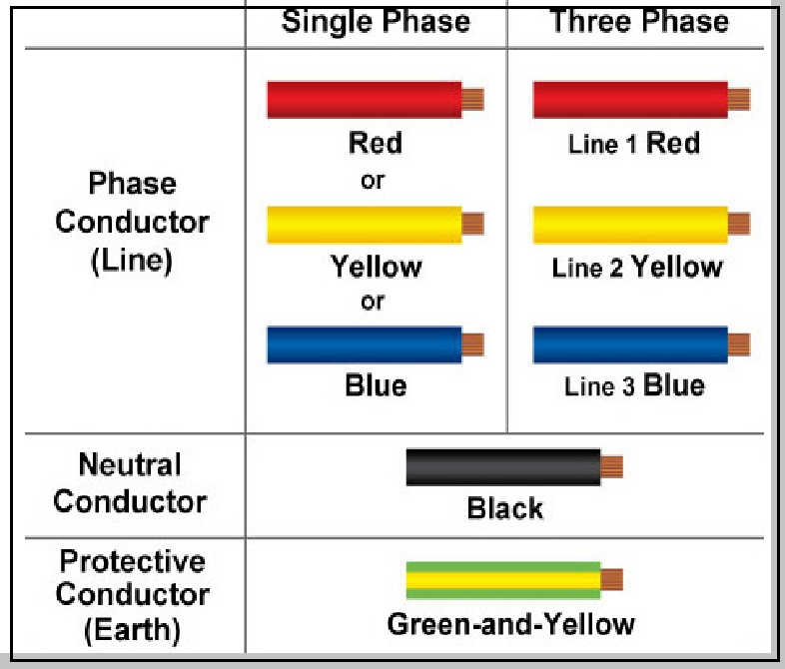
Conductor
Copper and aluminium wires are used as a conductor material in cables because of their high electrical conductivity. Solid or number of bare wires made of either copper or aluminium are used to make a power cable.

Slide 37
Insulation
The most commonly used dielectric in power cables is impregnated paper, butyl rubber, polyvinyl chloride cable, polyethylene, cross-linked polyethylene.
Paper insulated cables are mostly preferred because their current carrying capacity is high, generally reliable and having a long life.
The dielectric compound used for the cable should have following properties.
The insulator must have high insulation resistance.
It should have high dielectric strength so that it does not allow the leakage current to pass through it.
The material must have good mechanical strength.
The dielectric material should be capable of operating at high temperature.

Slide 38
Inner Sheath
It is used for protecting the cable from moistures which would affect the insulation.
Cable sheath is made up of lead alloy, and these strengths withstand the internal pressures of the pressurized cables.
The material used for inner sheath should be nonmagnetic material.
The aluminium sheath is also used in a power cable because it is cheaper, smaller in weight and high mechanical strength than the lead sheath.
In oil-filled cables and telephone cables, corrugated seamless aluminium sheath is used because it has better-bending properties, reduced thickness, and lesser weight.

Slide 39
Protective Covering
Lead sheath cables when directly laid down on the ground are damaged by corrosion and electrolyte.
For protecting the cables against corrosion, layers of fibrous material like paper, polyvinyl chloride is used.
Layers of fibrous material spread with the waterproof compound to the outside of the electrical cable are called serving.

Slide 40
Armouring
Armouring is the process in which layers of galvanized steel wires or two layers of metal tape are applied over sheath for protecting it from mechanical damage.
The steel wires are normally used for armouring because it has high longitudinal strength.
Armouring is also used for earthing the cable.
When the fault occurs in the cable (due to insulation failure) the fault current flows through the armour and get earthed.

Slide 41
Over-sheath
It gives the mechanical strength to the cables.
It protects the cable from overall damage like moisture, corrosion, dirt, dust, etc.
The thermosetting or thermoplastic material is used for making over the sheath.

Slide 42
Types of cables
Types of Electrical Cables Based on Voltage Rating
There are six types of cables used in the electrical wiring based on the voltage rating. They are, 1.Low tension (L.T) up to 1kV 2.High tension (H.T) up to 11kV 3.Super tension (S.T) 22kV to 33kV 4.Extra high tension (E.H.T) 33kV to 66kV 5.Oil Filled cables – 66kV to 132kV 6.Extra super voltage cables beyond 132kV

Slide 43
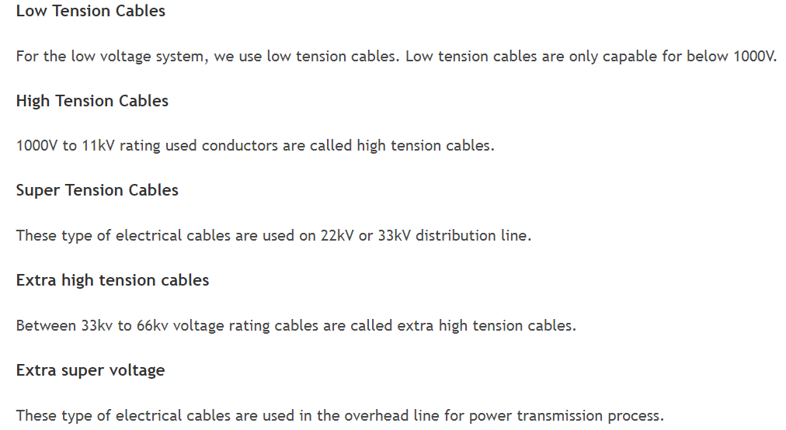

Slide 44
Types of Cables based on Cores and Applications
There are three types of cables are used in the domestic electrical construction areas. They are, 1.Power Cables 2.Control Cables 3.Instrument Cables
Which is the conductor used in the power transmitting that is called power cables. Power cables are carrying current to the circuit. The type of electrical cables are mostly used in the construction line. There are single core, two core, three core, three and half core & four core are the five type of power cables.
Cable Sizes: 1, 1.5, 2.5, 4, 6, 10, 16, 25, 35, 50, 70, 95, 120, 150, 240, 300, 400, 600 and 1000 sq.mm are the power cable sizes.

Slide 45
Single Core Cable
Single core cables are having only one core conductor itself and big sized and that would be Phase, Neutral or Earth. Single core conductor is only used in the high tension voltage system.
Two Core Cable
Manufactured by dual core conductor is called two core cables and that would be only Phase and Neutral. It is used in the low tension line.
Tri Core Cable
Three core cables are having triple cores and it would be three phases of red, yellow and blue. Tri core conductors are used in the 415V – low voltage system.

Slide 46
Three and Half Core
The type of electrical cables having itself four cores but last one core would be half size than others.
Red, Yellow and Blue of three phases are used to have first three cores. Last half size core used as neutral.
Three and half core is mostly used in the low voltage system.
Four Core Cables
3 Phases and neutral having conductor of the four core cables are would be made by four cores.
It is used in the low voltage system.

Slide 47
Control cables:
are used to control a electrical equipment system. Cable sizes of the control conductors are 0.75 sq.mm to 2.5 sq.mm. Control cables are mostly used on the instrument and electrical panels.
1.5 sq.mm and 2.5 sq.mm cable sizes are mostly used for panel internal wiring.
Cable Sizes – 0.75, 1, 1.5, 2.5sq.mm

Slide 48
Instrument Cables Types, Sizes and Uses
The type of cables are used in the instrument equipment such as transmitters, sensors and switches. Only needs direct current supply.
Cores – 2, 4, 6, 10, 12, 19, 27, 37, 40, 50 pair.
Cable Sizes – 0.5, 0.75 and 1sq.mm
Uses – Thermocouples, pressure transmitter, level transmitter, differential pressure transmitter and sensors.
Supply – 12V or 24V (DC)

Slide 49
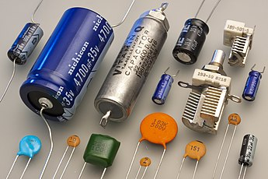
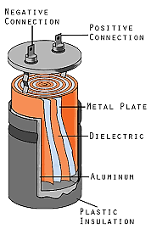
CAPACITOR
Capacitor is a component which has the ability or capacity to store electrical energy in the form of an electrical charge producing a potential difference (Static Voltage) across its plates.
It stores electrical energy in the form of electrostatic field.

Slide 50
There are many different kinds of capacitors available from very small capacitor beads used in resonance circuits to large power factor correction capacitors, but they all do the same thing, they store charge.
In its basic form, a capacitor consists of two or more parallel conductive (metal) plates.
These plates are electrically separated by dielectric medium such as air, waxed paper, mica, ceramic, plastic or some form of a liquid gel.
Due to this insulating layer, DC current can not flow through the capacitor as it blocks it allowing instead a voltage to be present across the plates in the form of an electrical charge.

Slide 51
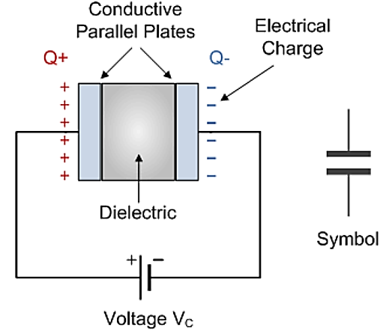
Working of Capacitor
Capacitance: Ratio of electric charge (Q) to the voltage (V).
C = Q/V
Where, Q is the electric charge in coulombs
C is the capacitance in farad
V is the voltage between the plates in volts

Slide 52
Types of Capacitors
Electrolytic Capacitor
Mica Capacitor
Paper Capacitor
Film Capacitor
Non-Polarized Capacitor
Ceramic Capacitor

Slide 53
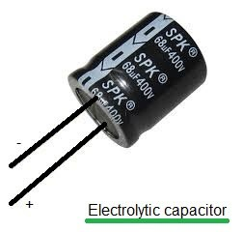
Electrolytic Capacitor
Generally, the electrolyte capacitors are used when the large capacitor values are required.
The thin metal film layer is used for one electrode and for the second electrode (cathode) a semi-liquid electrolyte solution which is in jelly or paste is used.
The dielectric plate is a thin layer of oxide, it is developed electrochemically in production with the thickness of the film and it is less than the ten microns.
This insulating layer is very thin, it is possible to make capacitors with a large value of capacitance for a physical size, which is in small and the distance between the two plates is very small.

Slide 54
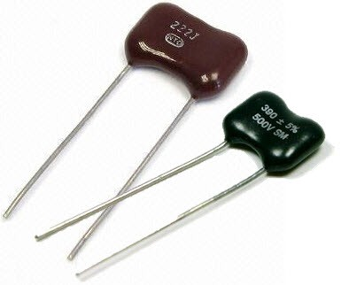
Mica Capacitor
This capacitor is a group of natural minerals and the silver mica capacitors use the dielectric. There are two types of mica capacitors which are clamped capacitors & silver mica capacitor.
Clamped mica capacitors are considered as an obsolete because of their inferior characteristic. The silver mica capacitors are prepared by sandwiching mica sheet coated with metal on both sides and this assembly is then encased in epoxy to protect the environment.
The mica capacitors are used in the design calls for stable, reliable capacitor of relatively small.
The mica capacitors are the low loss capacitors, used at high frequencies and this capacitor is very stable chemically, electrically, and mechanically, because of its specific crystalline structure binding & it is a typically layered structure.

Slide 55
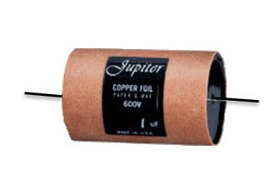
Paper Capacitor
The construction of paper capacitor is between the two tin foil sheet and they are separated from the paper, or, oiled paper & thin waxed.
The sandwich of the thin foils and papers then rolled into the cylindrical shape and then it is enclosed into the plastic capsule.
The two thin foils of the paper capacitors attach to the external load.
In the initial stage, paper was used in between the two foils of the capacitor, but these days the other materials like plastics are used, therefore it is called as a paper capacitor. The capacitance range of the paper capacitor is from 0.001 to 2 micro farad and the voltage is very high which is up to 2000V.

Slide 56
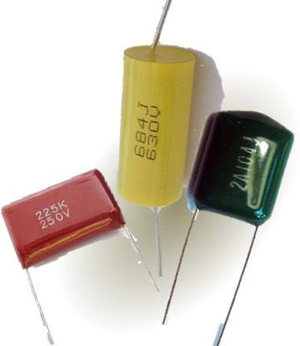
Film Capacitor
The film capacitors use a thin plastic as the dielectric. The film capacitor is prepared extremely thin using the sophisticated film drawing process.
Different types of film capacitors are available like polyester film, metallized film, polypropylene film, PTE film and polystyrene film. The core difference between these capacitors types is the material used as a dielectric and dielectric should be chosen properly according to their properties.
The properties of the film capacitors are stability, low inductance, and low cost.
Some film capacitors can withstand large reactive power values.

Slide 57
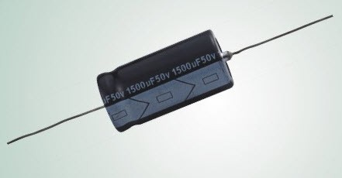
Non-Polarized Capacitors
Capacitors with neither positive nor negative polarity are known as non-polarized capacitors.
classified into two types plastic foil capacitor and the other one is the electrolytic non-polarized capacitor.
Non-polarized capacitors’ two electrodes can be put into the circuit at random and will not leak. They’re typically found in the coupling, decoupling, compensation, feedback, and oscillation circuits.
The examples are the speaker crossover filters and power factor correction network. In these two applications, a large AC voltage signal is applied across the capacitor.
Non-polarized capacitors are used in pure AC circuits and can also be used for high-frequency filtering due to their modest capacitance.

Slide 58
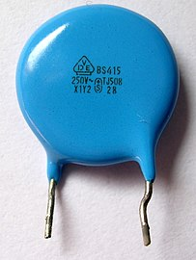
Ceramic Capacitor
A ceramic capacitor is a non-polarized fixed capacitor made out of two or more alternating layers of ceramic and metal in which the ceramic material acts as the dielectric and the metal acts as the electrodes.
The ceramics are one of the first materials to use in the production of capacitors as an insulator.
The two common types of ceramic capacitors are multilayer ceramic capacitor (MLCC) and ceramic disc capacitor.
The values of the ceramic capacitors are typically between the 1nF and 1µF and the values are up to 100µF are possible.

Slide 59
The capacitor used for storage of energy.
It is used in filter circuits to minimize the ripple voltage.
Capacitors are used to run the motor.
Bypass the high frequency signals.
Used in tank circuits in electronic oscillators.
In Sensor circuits
Power conditioning
Power factor correction

Slide 60
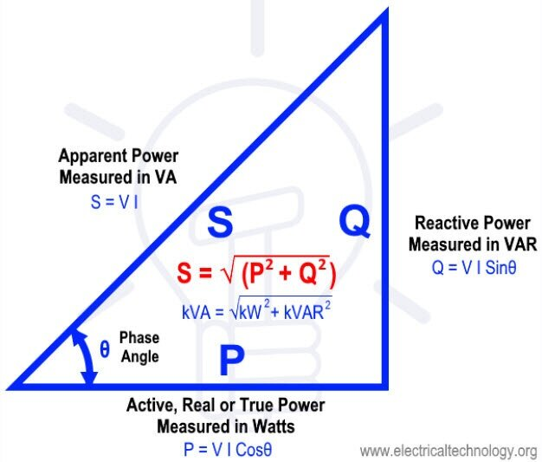
Power factor correction
Power factor of an AC power system is defined as the ratio of the Active power absorbed by the load to the apparent power.
In AC circuits, the value of power factor lies between 0 and 1.
Real Power – The power supplied to the equipment that performs useful and productive work.
Reactive Power– The power required by equipment such as transformers and motors to produce magnetic fields enabling actual work to be done.
Apparent Power– The phase or sum of real power and reactive power.
PF = cosɸ = P(W) / S(VA)

Slide 61
Causes of Low Power Factor
Inductive Load: 90% of the industrial loads consist of induction motors. Such machines draw magnetizing current and set up a magnetic field for its proper working and hence work at a low power factor. The current drawn by inductive loads is lagging and results in poor power factor.
Harmonic Current: The presence of harmonic current reduces the power factor in the system.
Variation in the Power System Loading

Slide 62
Effects of Low Power Factor
Large Copper Losses: When the power factor is low, the line current will be high, and consequently, the copper losses will be higher. This results in low efficiency of the power system.
Large kVA rating: power factor of the machine is inversely proportional to its kVA rating. Larger kVA rating makes the equipment costly and heavier in size.
Poor Voltage Regulation: higher voltage drop in transformers and alternators.

Slide 63
Power Factor Correction
The power factor correction is a technique of increasing the power factor of a power supply.
In electric power distribution, capacitors are used for power-factor correction. There are two methods:
Power Factor Correction Method using Capacitors.
Power Factor Correction Method using a Synchronous Condenser.
The purpose is to counteract inductive loading from devices like electric motors and transmission lines to make the load appear to be mostly resistive.
An over-excited synchronous motor has a leading power factor. This makes it useful for power-factor correction of industrial loads.

Slide 64
